Slide 1


Slide 2

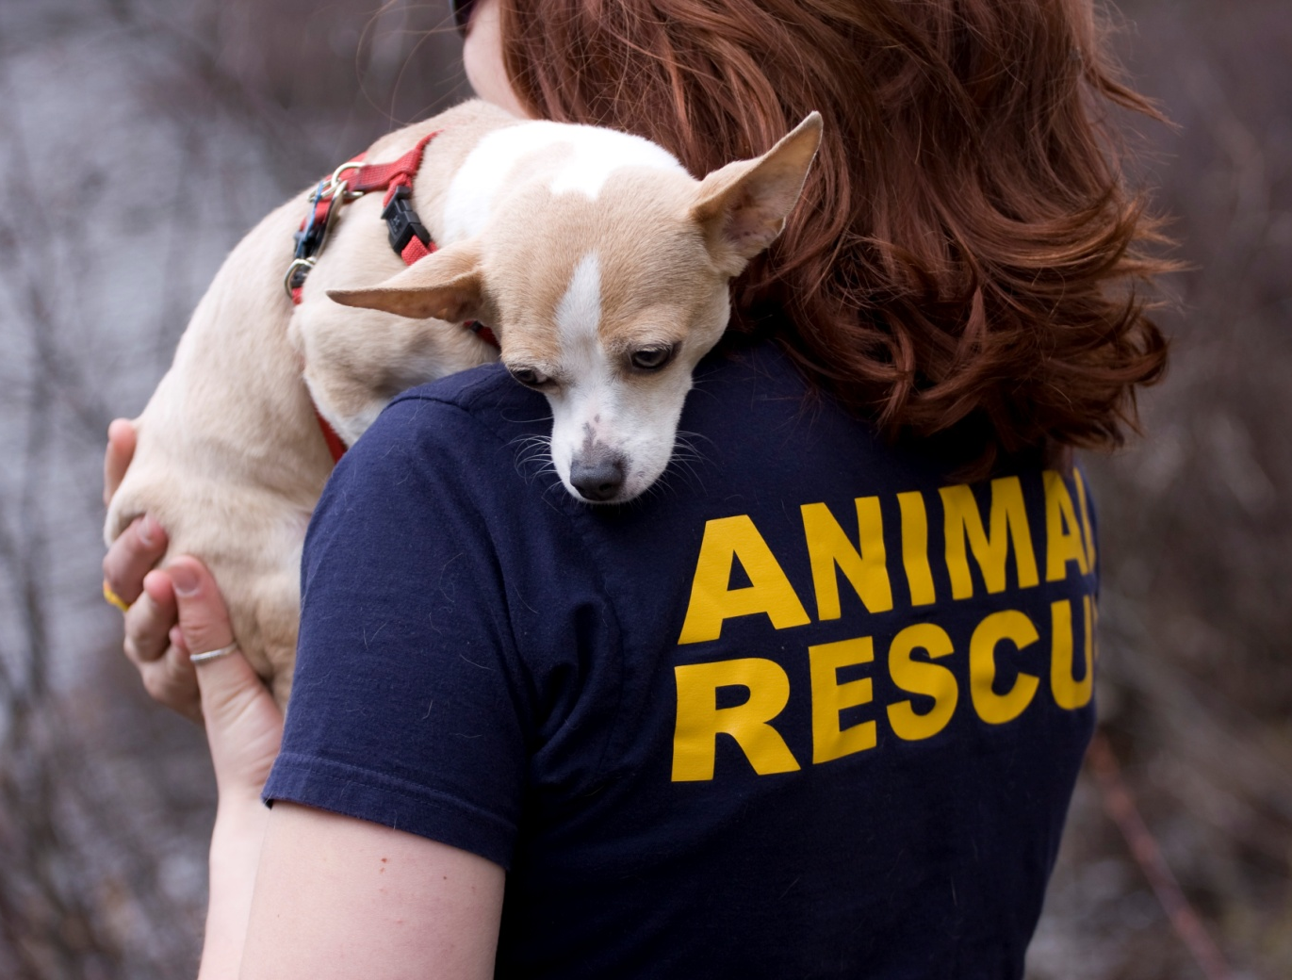
About AEI
Animal Experience International matches people seeking volunteer positions with animal-related organizations around the world that need volunteers.

Slide 3
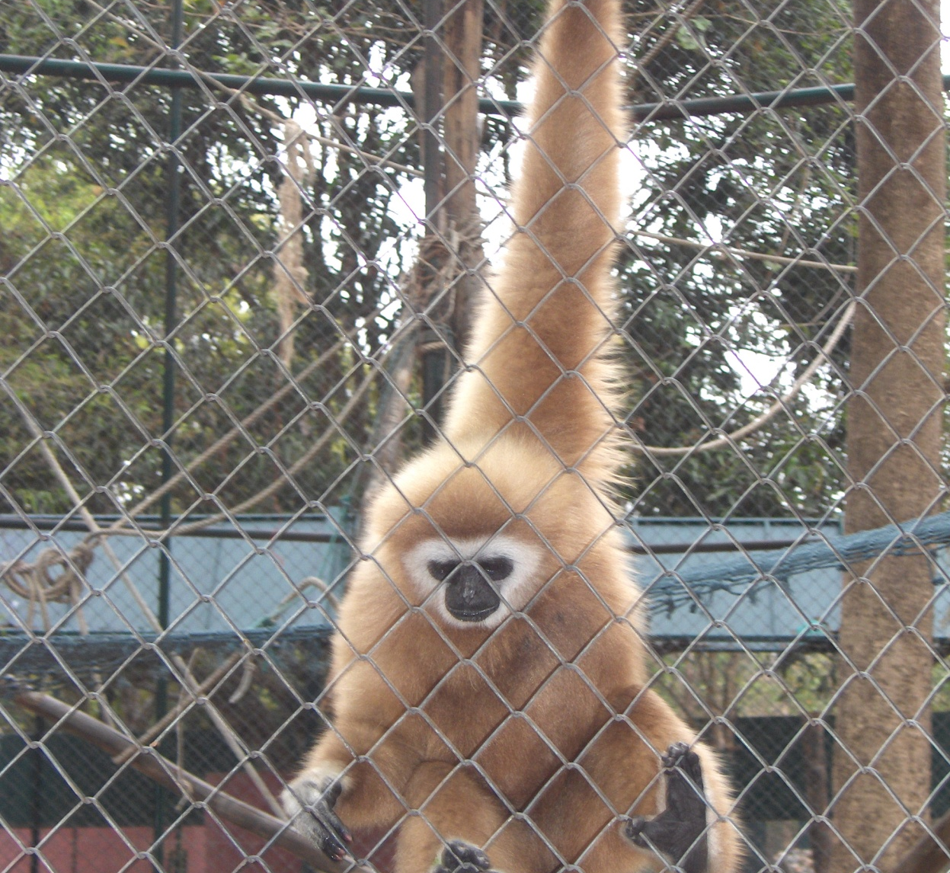
Placements
Each AEI placement works directly with animals, including;
Wildlife Rescue Centers
Animal Sanctuaries
Wildlife Hospitals
Conservation programs
Spay-neuter-vaccination programs

Slide 4
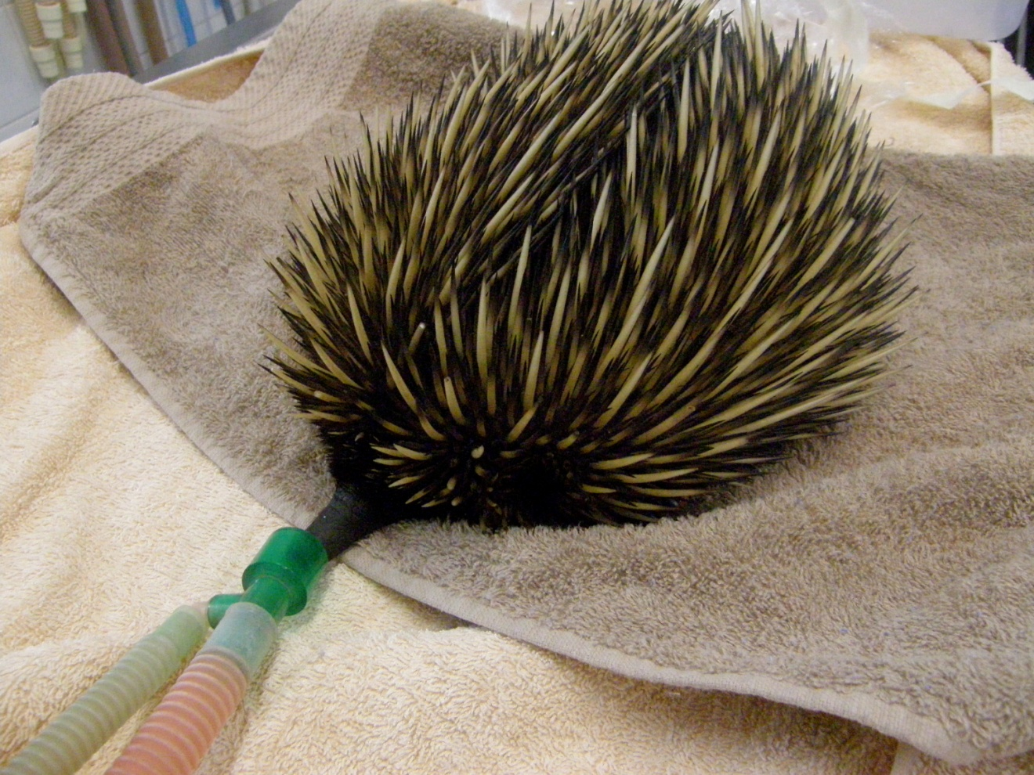
Placements
AEI placements have all been evaluated to assess the level of veterinary involvement
We match our clients’ skills and expectations with the needs of each placement

Slide 5
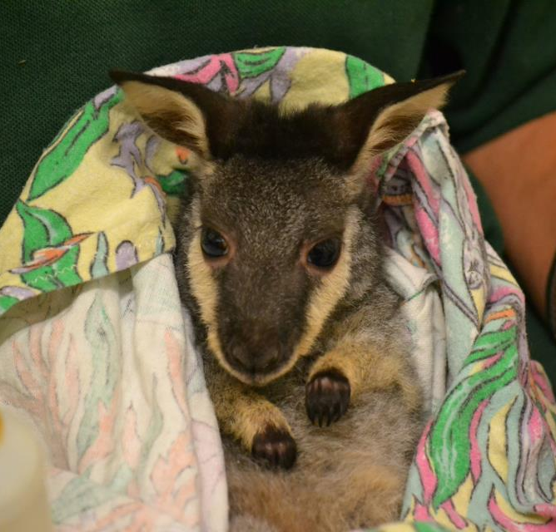
Placements
AEI placements are safe and straight forward
Everything is included – airport pick-up, meals, accommodation, training, emergency support, travel insurance and more
We take care of the details so you can take care of the animals.

Slide 6
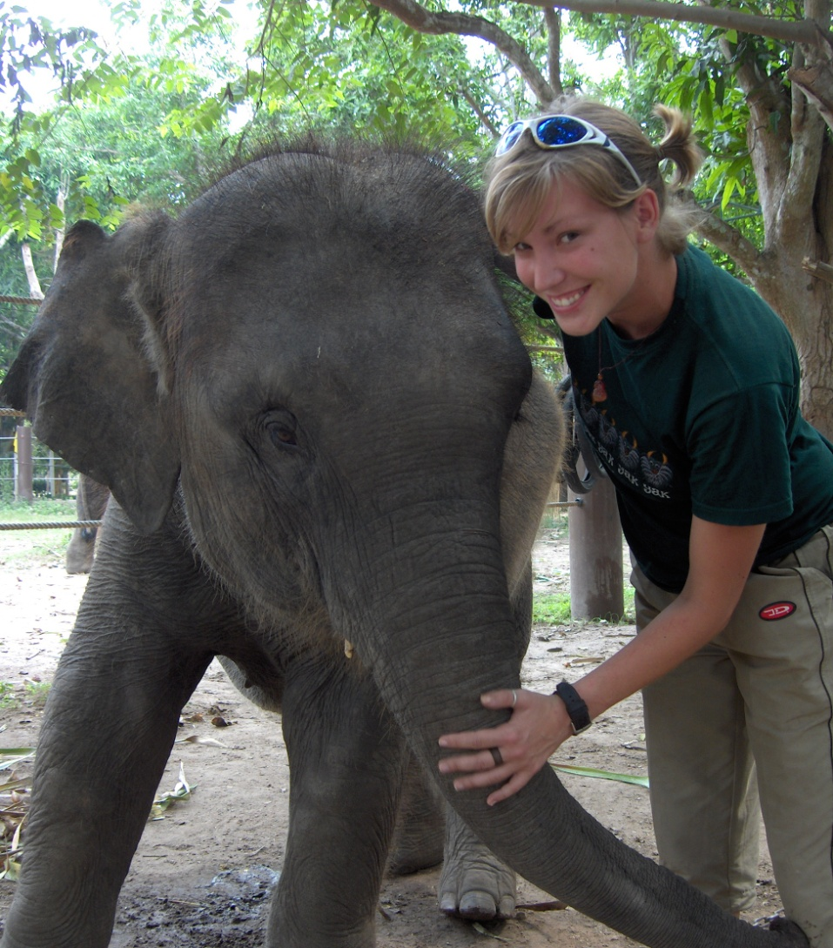
Veterinary Technician Students
Veterinary technician students have skills that benefit animal organizations
You bring your training and education, ethical standards, professionalism and your ability to work as part of the health care team

Slide 7
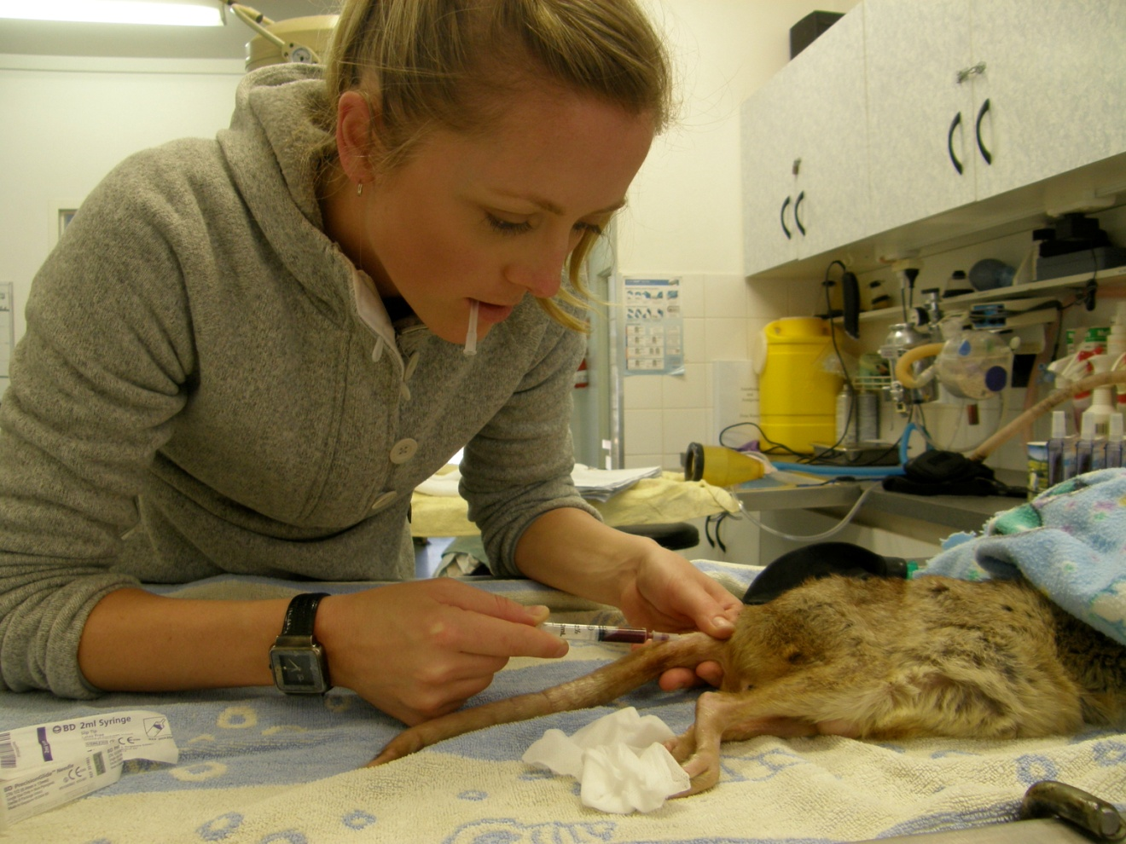
Veterinary Technician Students
In return, AEI placements offer you opportunities to gain experience in specialty areas
Supplement your career with different experiences

Slide 8
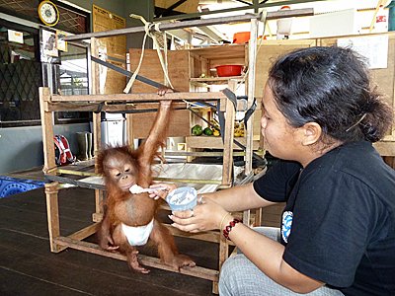
Veterinary Technician Students
You can gain experience in the field
Find opportunities for future employment
Make connections, meet new people
Travel to new places, experience different cultures

Slide 9
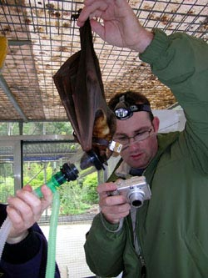
Veterinary Technician Students
You can gain exposure to areas such as research, captive breeding programs, policy development and education
As well as areas that are not medical such as fundraising, cage construction and office administration

Slide 10
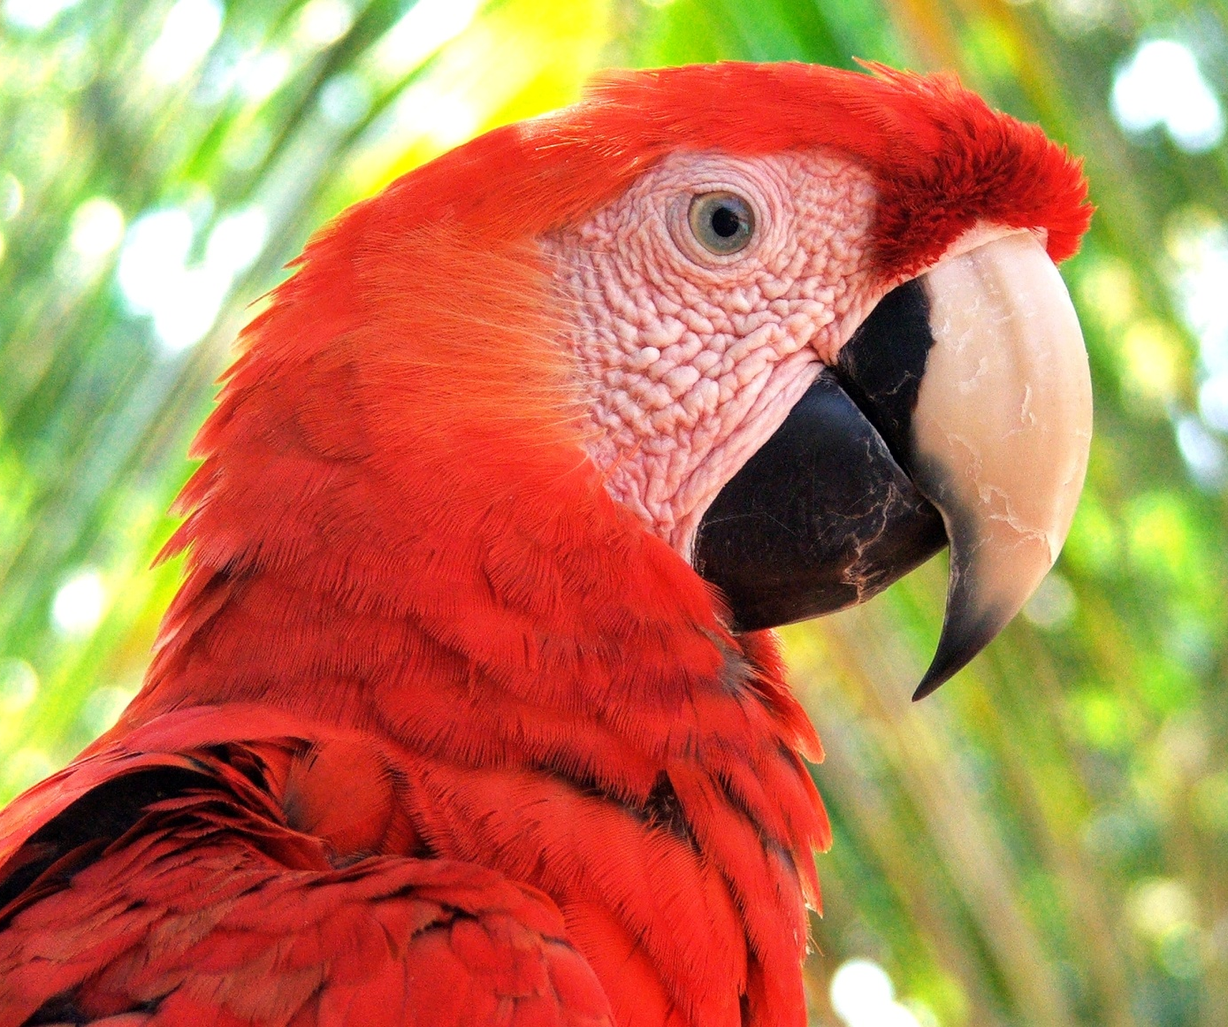
AEI Placements
Placements are available all over the world, in more than 10 countries.
All placements have aspects of animal care.
Most have a specific veterinary component.

Slide 11
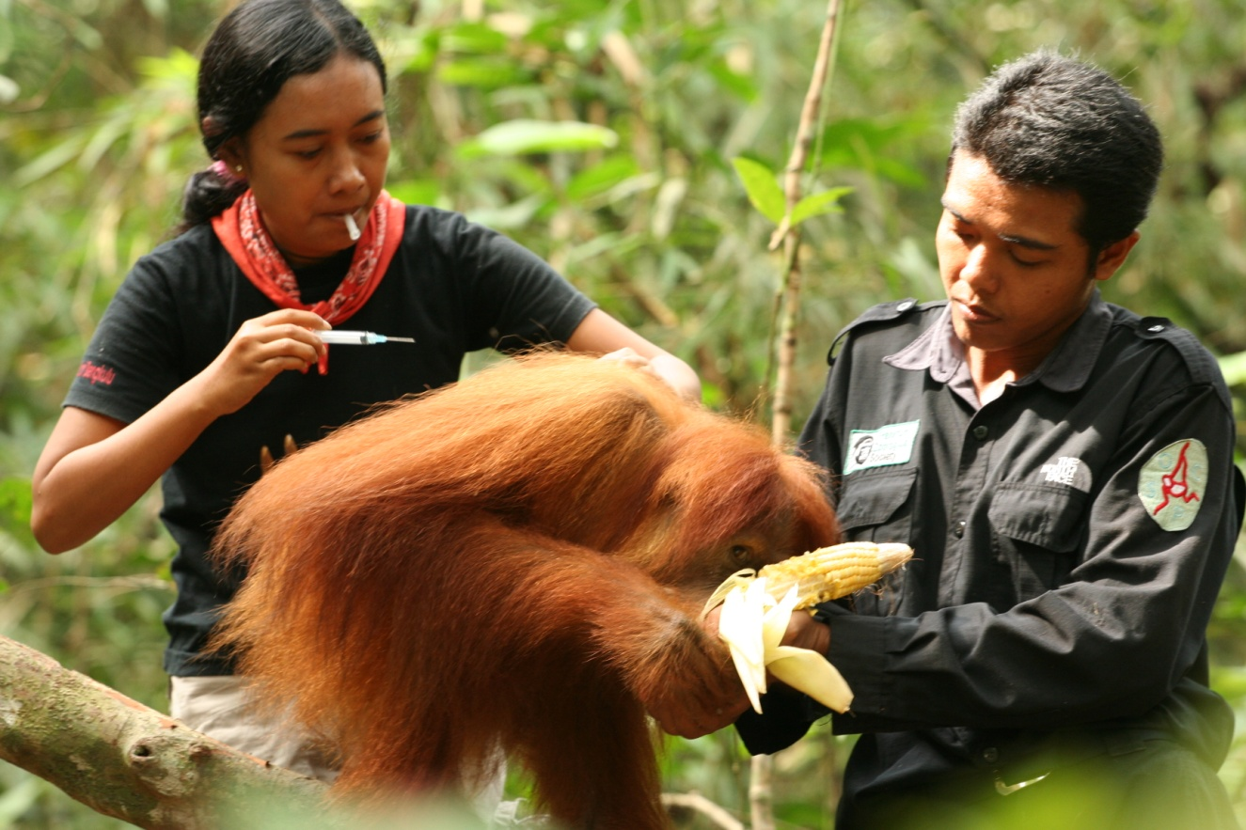
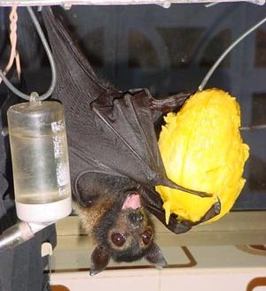
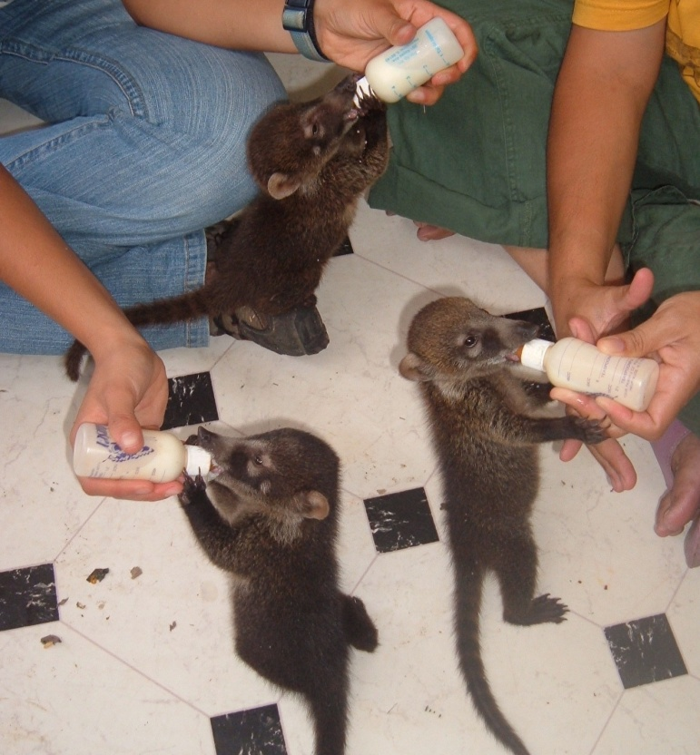
AEI Placements
Assist with orangutan conservation in Sumatra
Help flying foxes at a bat hospital in Australia
Treat baby coatis at a wildlife rescue center in Guatemala

Slide 12
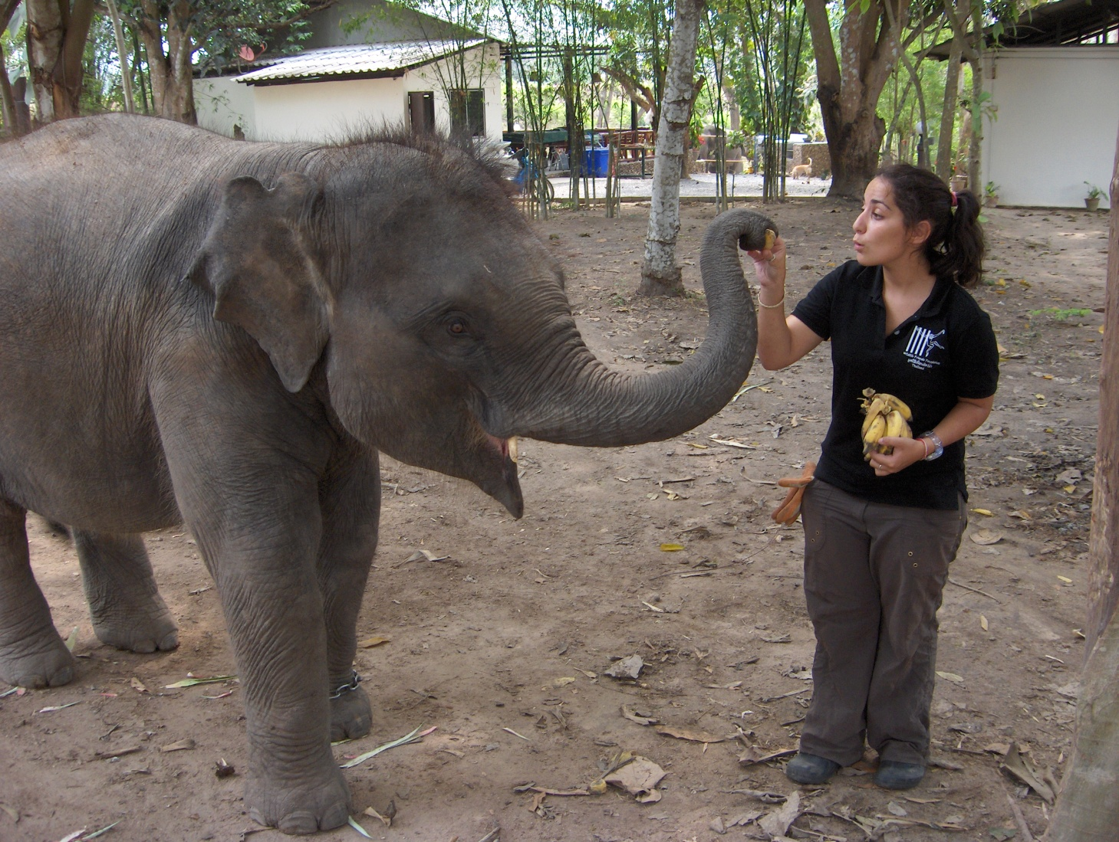
AEI Placements
How it works: choose your own adventure!
You select the project and species you wish to work with
Choose the country you wish to visit
Decide when you want to travel and the length of your placement – all of AEI’s partners need volunteers year round

Slide 13
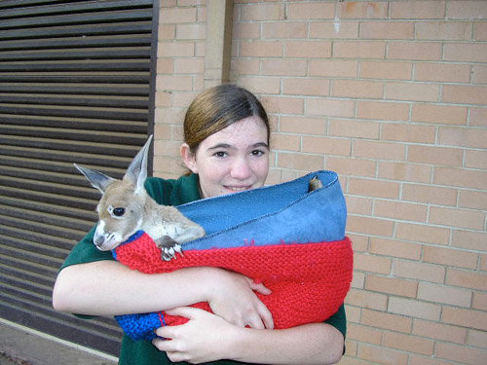
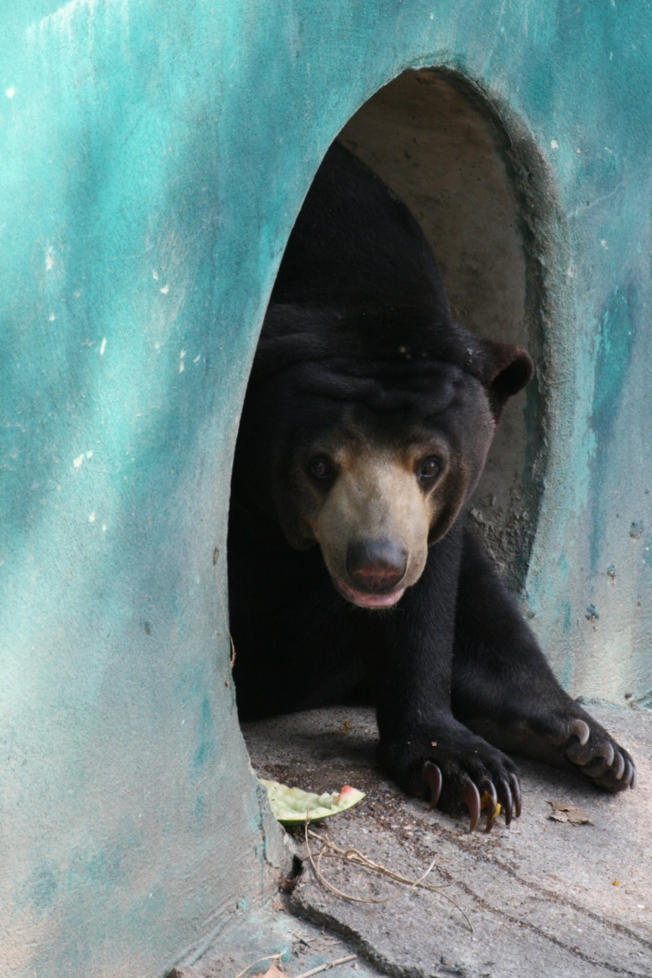
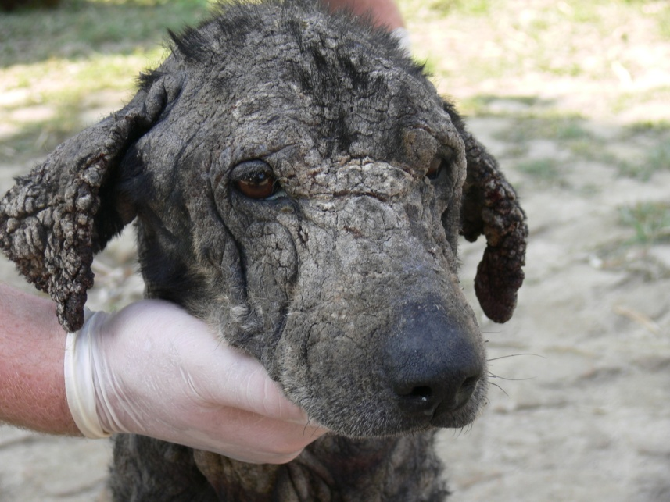
AEI Placements
Help at a wildlife sanctuary in Thailand
Participate in wildlife rescue in Australia
Treat, neuter and vaccinate street dogs in Nepal

Slide 14
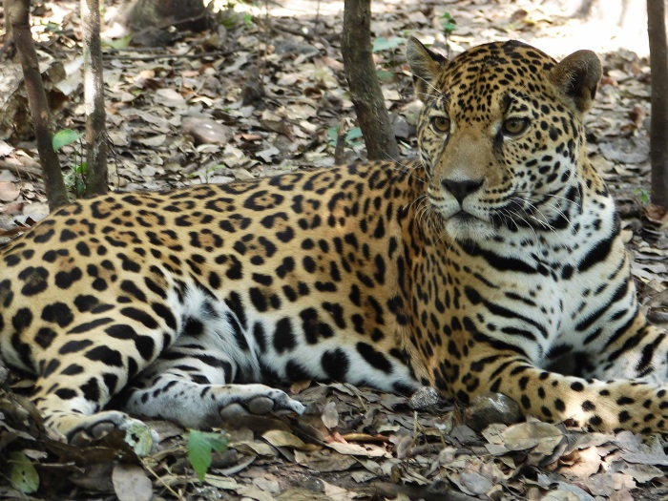
AEI Placements
AEI’s Volunteer Coordinator works with you to ensure the placement will meet your expectations
Placements may qualify as a clinical placement for your program
We work with your school to ensure the placement meets your program’s educational requirements

Slide 15
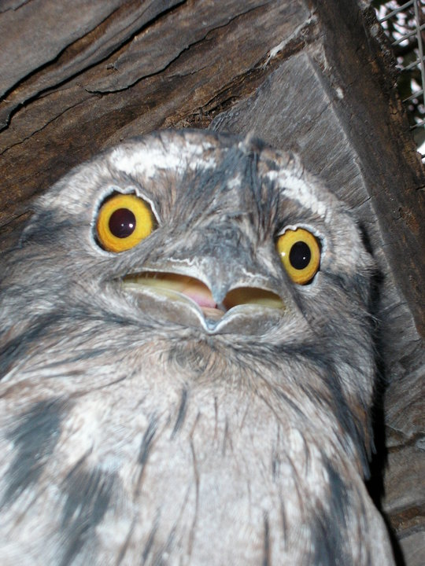
I have to pay to volunteer?
For organizations to remain sustainable, volunteers must cover their basic costs - for food accommodation and the supplies and equipment used
Your volunteer fees also cover other great things like your airport pickup, training, travel insurance, emergency support, carbon balancing of your trip and a donation to the partner
Volunteer fees do not include airfare, travel visas, or immunizations

Slide 16




Fundraising with AEI
AEI offers fundraising support to ensure everyone can participate in the placement of their choice
It is possible to pay for all of your placement costs through fundraising!

Slide 17
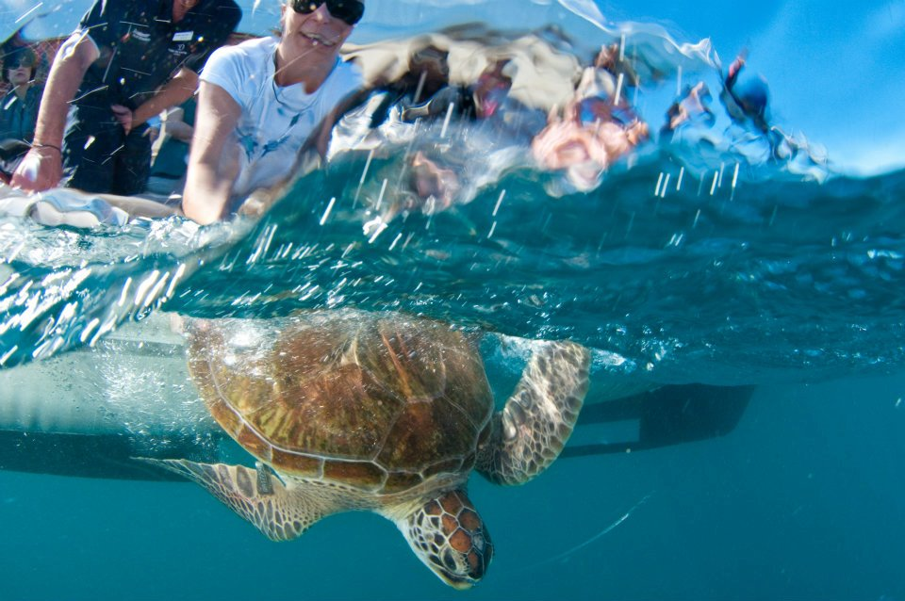
Live your dreams. Travel the world. Volunteer with animals
Applications are made on-line
For more information about AEI and AEI’s Placements visit our website or contact us at info@animalei.com
© Christian Miller
www.animalexperienceinternational.com

